Slide 1
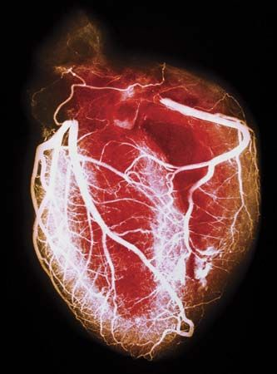
Cornelia de Lange Syndrome (CdLS) and Nipped B-like protein (NIPBL)
By: Jared Akers

Slide 2
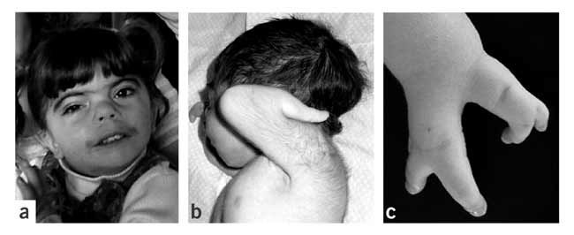
What is Cornelia de Lange Syndrome?
Figure 1: Characteristic features of CdLS. [1]
Estimates very for prevalence of CdLS.
Multi-system developmental disorder.
1.) Strachan, Tom. “Cornelia De Lange Syndrome and the Link between Chromosomal Function, DNA Repair and Developmental Gene Regulation.” Current Opinion in Genetics & Development, vol. 15, no. 3, 2005, pp. 258–264., doi:10.1016/j.gde.2005.04.005.

Slide 3
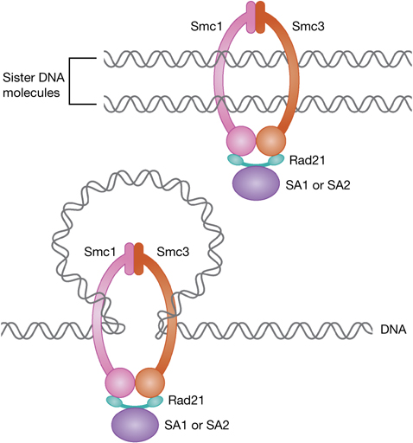
What is a cohesinopathy?
A developmental disorder caused by mutations in genes that interact with or are a part of the cohesin complex [2].
2.) Muto, A., Calof, A., Lander, A., & Schilling, T. (2011). Cornelia de Lange syndrome is caused by mutations in NIPBL, the human homolog of Drosophila melanogaster Nipped-B. PLoS Biol. doi:https://doi.org/10.1371/journal.pbio.1001181

Slide 4
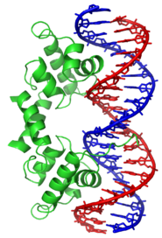
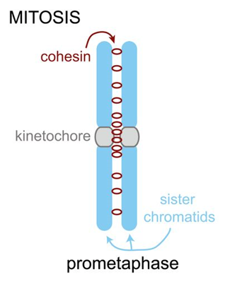
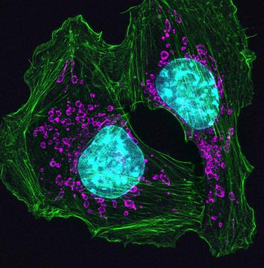
Nipped B-like protein (NIPBL)
Molecular function
Biological process
Cellular component
Chromatin
binding
Sister chromatid cohesion
Transcriptional regulation
Nucleus

Slide 5
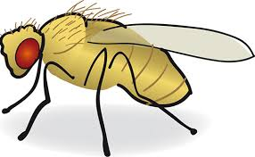
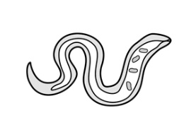
Domains and homology of NIPBL
Nipped-B_C
HEAT repeats
Signaling

Slide 6
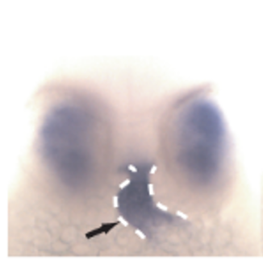
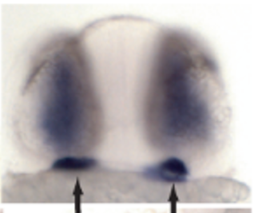
Modeling CdLS with Zebrafish
Spoiler alert!
Chemical libraries ahead!
Wild type (WT)
Mutant
Heart, 32 hours post
fertilization (hpf)
Figure 3, (A). [3]
Figure 3, (A). [3]
Zebrafish 52 hpf
Heart
3.) Muto, A., Calof, A. L., Lander, A. D., & Schilling, T. F. (2011). Multifactorial Origins of Heart and Gut Defects in nipbl-Deficient Zebrafish, a Model of Cornelia de Lange Syndrome [Abstract]. PLoS Biology,9(10). doi:10.1371/journal.pbio.1001181

Slide 7
Modeling CdLS with Zebrafish
Spoiler alert!
Chemical libraries ahead!
Wild type
Mutant
Heart, 32 hours post
fertilization (hpf)
Cardia bifida
Heart tube
Figure 3, (A). [3]
Figure 3, (A). [3]
Zebrafish 52 hpf
Figure 2, (C). [3]
Heart
Figure 2, (C). [3]
3.) Muto, A., Calof, A. L., Lander, A. D., & Schilling, T. F. (2011). Multifactorial Origins of Heart and Gut Defects in nipbl-Deficient Zebrafish, a Model of Cornelia de Lange Syndrome [Abstract]. PLoS Biology,9(10). doi:10.1371/journal.pbio.1001181

Slide 8
Gap in knowledge
How NIPBL mediates heart development.

Slide 9
Gap in knowledge
How NIPBL mediates heart development.
Research goal
Characterize the amino acids in NIPBL that are critical to heart development.

Slide 10
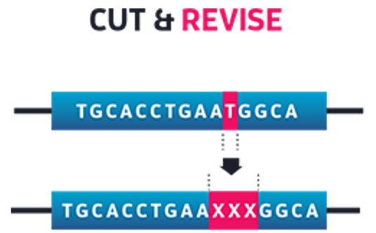
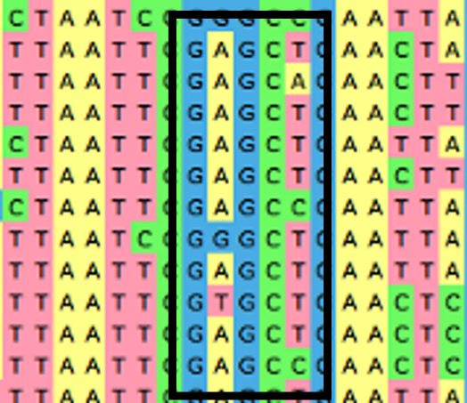
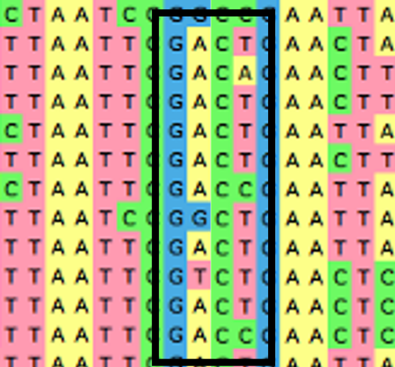
Aim 1: Determine NIPBL amino acids critical to heart development
Align
Mutagenize
Observe

Slide 11
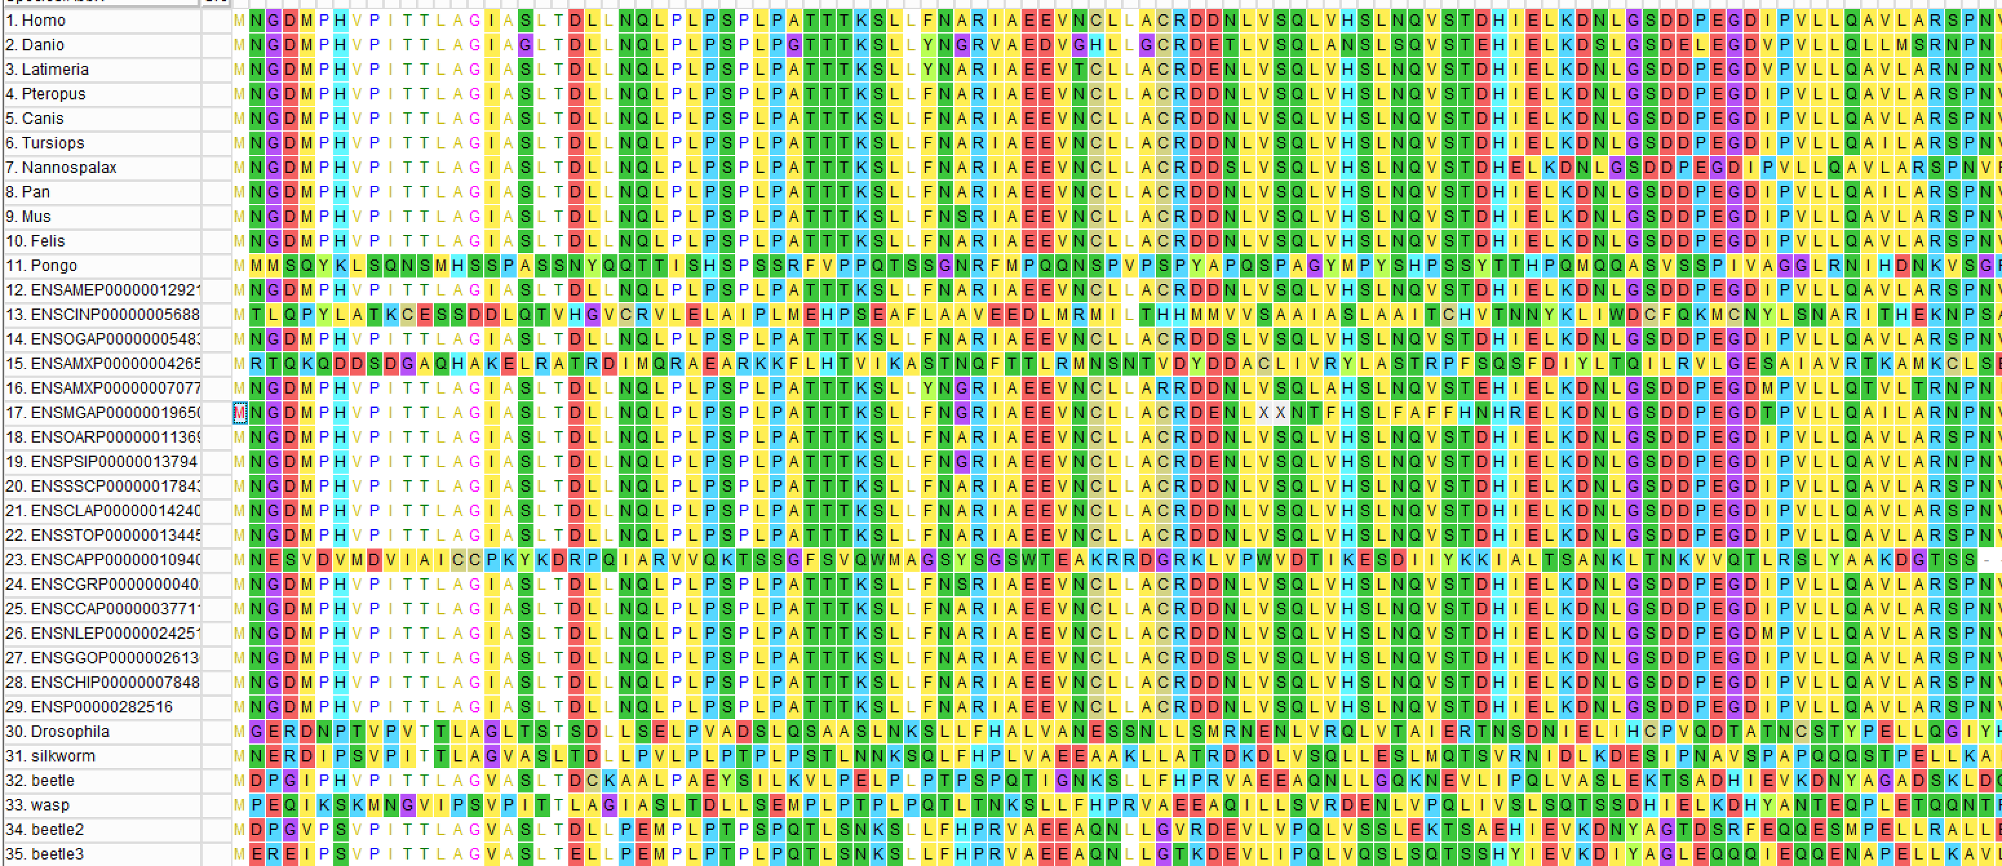
Aligned simple and complex hearts
Sites of 80 percent conservation

Slide 12
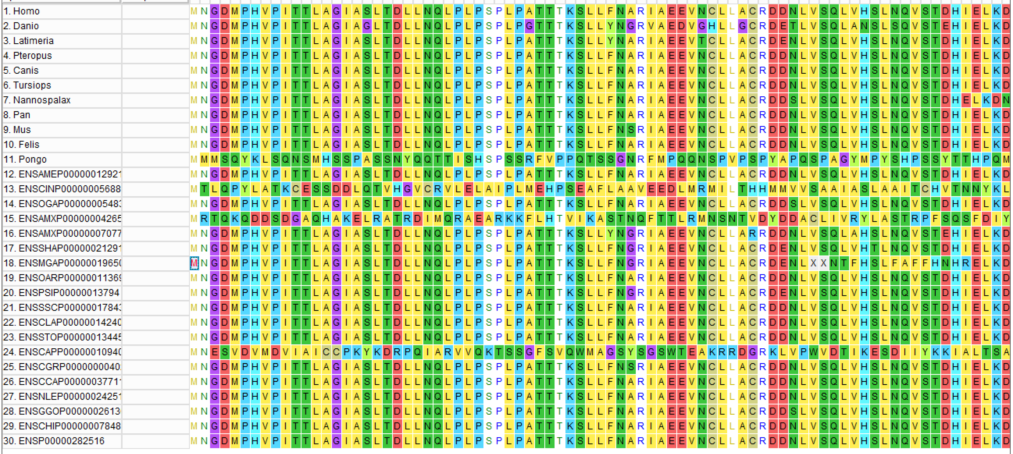
Aligned 30 organisms with complex hearts
Sites of 90 percent conservation

Slide 13
Unique conservation of complex heart organisms
Sites of 80% conservation in complex and simple hearts
6 | 8 | 9 | 10 | 11 | 12 | 13 | 14 | 15 | 17
P | V | P | I | T | T | L | A | G | A
19 | 20 | 23 | 27 | 31 | 41 | 54
L | T | L | P | P | L | L
Sites of 90% conservation in complex hearts
2 | 30 | 31 | 37 | 45 | 54 | 57
N | S | P | T | R | L | R

Slide 14
Unique conservation of complex heart organisms
Sites of 80% conservation in complex and simple hearts
6 | 8 | 9 | 10 | 11 | 12 | 13 | 14 | 15 | 17
P | V | P | I | T | T | L | A | G | A
19 | 20 | 23 | 27 | 31 | 41 | 54
L | T | L | P | P | L | L
Sites of 90% conservation in complex hearts
2 | 30 | 31 | 37 | 45 | 54 | 57
N | S | P | T | R | L | R

Slide 15
Unique conservation of complex heart organisms
Sites of 80% conservation in complex and simple hearts
6 | 8 | 9 | 10 | 11 | 12 | 13 | 14 | 15 | 17
P | V | P | I | T | T | L | A | G | A
19 | 20 | 23 | 27 | 31 | 41 | 54
L | T | L | P | P | L | L
Sites of 90% conservation in complex hearts
2 | 30 | 31 | 37 | 45 | 54 | 57
N | S | P | T | R | L | R
Unique to complex
hearts
2 | 30 | 31 | 37 | 45 | 54 | 57
N | S | P | T | R | L | R

Slide 16
Aim 1: Determine NIPBL amino acids critical to heart development
Align
Mutagenize
Observe

Slide 17
Aim 1: Determine NIPBL amino acids critical to heart development
Align
Mutagenize
Observe
WT
Mutant

Slide 18
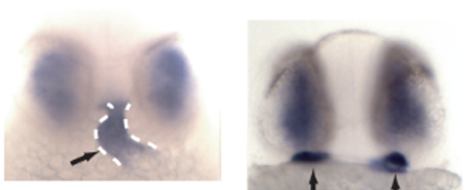
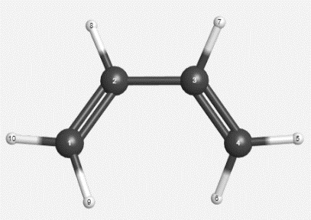
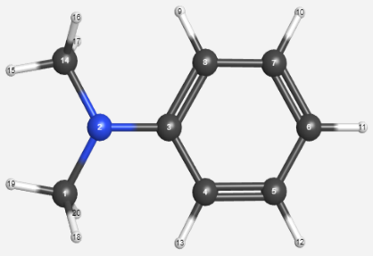
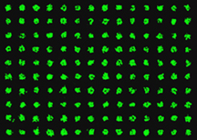
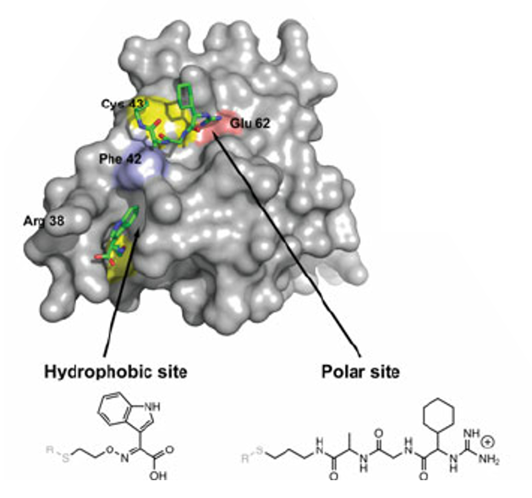
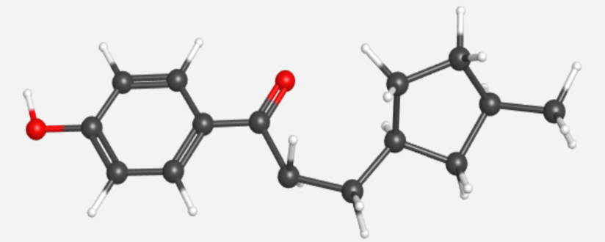
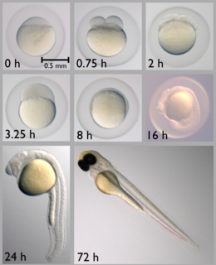
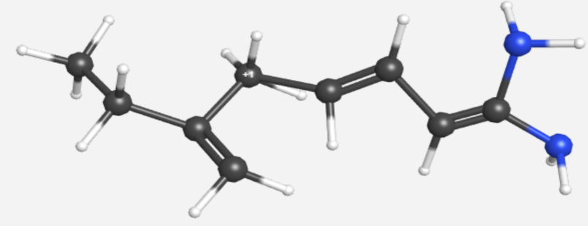
Aim 2: Find molecules capable of rescuing phenotype
Choose chemical library
Biochemical screen
In-vivo
screen

Slide 19
Chemical libraries
Function oriented
Broad library

Slide 20
Chemical libraries
Function oriented
Broad library

Slide 21
Aim 2: Find small molecules with amino acid specificity
Broad chemical library
Biochemical screen
In-vivo
screen

Slide 22
Protein microarray for broad chemical library
Before using array attach GFP at the less conserved C terminus.

Slide 23
Aim 2: Biochemical screen for broad library
Mutant @
31
S
array
gfp-NIPBL is bound

Slide 24
Aim 2: Biochemical screen for broad library
Wild type
31
S
Mutants @
46
R
96
L
*Overlay of four microarrays

Slide 25
Aim 2: Find small molecules with amino acid specificity
Broad chemical library
Biochemical screen
In-vivo screen and PubChem search
WT
Mutant

Slide 26
Aim 2: Find small molecules with amino acid specificity
Function oriented chemical library
In-vivo screen
WT
Mutant

Slide 27
Aim 2: Investigate binding molecules
Origin
Function oriented
library
In-vivo screen
Characterized
Broad library
Biochemical screen
In-vivo screen

Slide 28
Aim 2: Investigate binding molecules
Search small molecule on PubChem to figure out how it rescues the phenotype.
Origin
Function oriented
library
In-vivo screen
Characterized
Characterize
with
Broad library
Biochemical screen
In-vivo screen

Slide 29
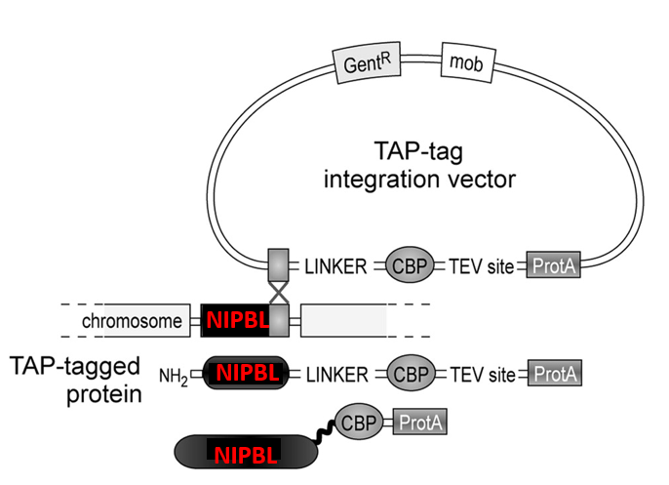
Aim 3: Discover amino acid specific interactions
Connect TAP-tag to NIPBL
Pull-down & mass spec.
GO term search

Slide 30
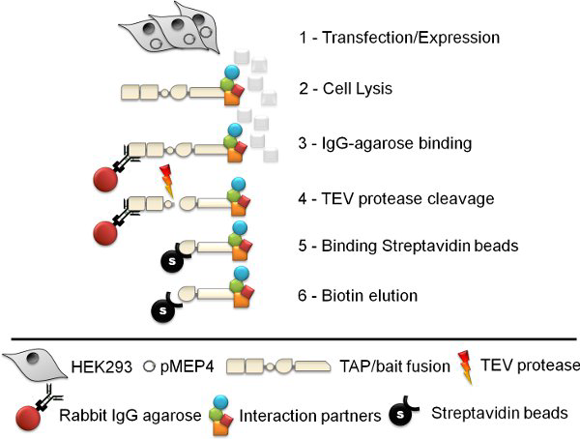
Aim 3: Discover amino acid specific interactions
Connect TAP-tag to NIPBL
Pull-down & mass spec.

Slide 31
Aim 3: Results of pulldown and mass spec.
Interacting partners
Wild type
30
S
Mutant @
45
R

Slide 32
Aim 3:GO annotation
Partners without heart GO terms
Partners with heart GO terms
Wild type
31
S
Mutant @
46
R

Slide 33
Aim 3:GO annotation
Partners without heart GO terms
Partners with heart GO terms
Wild type
31
S
Mutant @
46
R

Slide 34
Aim 3: Discover amino acid specific interactions
Connect TAP-tag to NIPBL
Pull-down & mass spec.
GO term search

Slide 35
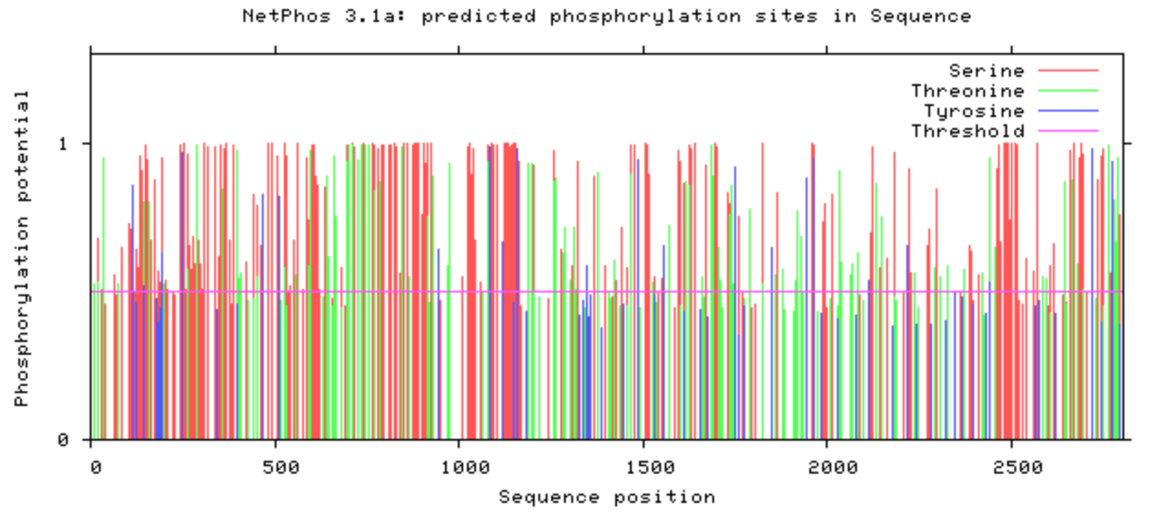
Future directions
If phosphorylation of conserved Serine is important to heart development.
30
S

Slide 36
Future directions
Focused chemical libraries and testing in a mouse model.

Slide 37
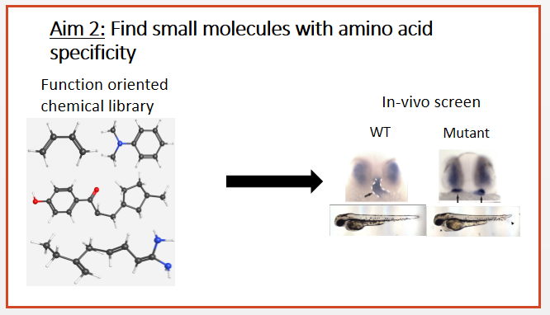
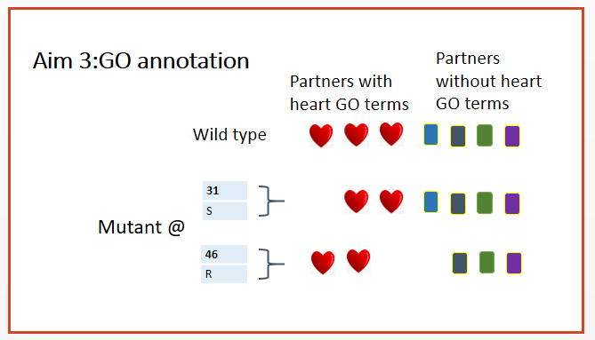
Conclusions

Slide 38
References
1.) Muto, A., Calof, A. L., Lander, A. D., & Schilling, T. F. (2011). Multifactorial Origins of Heart and Gut Defects in nipbl-Deficient Zebrafish, a Model of Cornelia de Lange Syndrome [Abstract]. PLoS Biology,9(10). doi:10.1371/journal.pbio.1001181
2.) Muto, A., Calof, A., Lander, A., & Schilling, T. (2011). Cornelia de Lange syndrome is caused by mutations in NIPBL, the human homolog of Drosophila melanogaster Nipped-B. PLoS Biol. doi:https://doi.org/10.1371/journal.pbio.1001181
3.) Strachan, Tom. “Cornelia De Lange Syndrome and the Link between Chromosomal Function, DNA Repair and Developmental Gene Regulation.” Current Opinion in Genetics & Development, vol. 15, no. 3, 2005, pp. 258–264., doi:10.1016/j.gde.2005.04.005.

Slide 39
Image citations
http://emboj.embopress.org/content/31/9/2061
https://en.wikipedia.org/wiki/DNA-binding_protein
http://www.genetics.org/content/196/1/31.figures-only
https://www.coursesource.org/courses/bad-cell-reception-using-a-cell-part-activity-to-help-students-appreciate-cell-biology-with
https://free.clipartof.com/details/57-Free-Cartoon-Gray-Field-Mouse-Clipart-Illustration
http://www.ourclipart.com/clipart/zebrafish%20clipart/
http://explorecuriocity.org/Explore/ArticleId/2964/fruit-flies-use-alcohol-as-a-defensive-weapon-2964.aspx
https://commons.wikimedia.org/wiki/File:Arabidopsis_thaliana_by_togopic.png
https://www.123rf.com/clipart-vector/yeast.html?sti=mfi7t6ydgn2vpzayg7|
http://2015.igem.org/Team:BNU-CHINA/Module
https://www.istockphoto.com/illustrations/chimpanzee?excludenudity=true&sort=mostpopular&mediatype=illustration&phrase=chimpanzee
https://www.biography.com/people/morgan-freeman-9301982
http://ugene.net/multiple-sequence-alignment-with-muscle/
http://www.editasmedicine.com/crispr
https://www.medchemexpress.com/
http://www.chembridge.com/
http://basictranslational.onlinejacc.org/content/2/1/1
https://www.researchgate.net/figure/Small-molecule-binding-sites-of-IL-2-explored-through-tethering-a-Principle-of_fig7_45630861
http://sabatinilab.wi.mit.edu/sabatini_public/reverse_transfection/frame.htm
http://iovs.arvojournals.org/article.aspx?articleid=2165272
http://eol.org/pages/204011/details
http://www.pnas.org/content/102/31/11082/
https://www.researchgate.net/figure/Schematic-of-the-tandem-affinity-purification-procedure-The-six-step-tandem-affinity_fig1_221682150
https://cherrylab.stanford.edu/projects/gene-ontology-consortium
https://pubchem.ncbi.nlm.nih.gov/
https://lifestyle.howstuffworks.com/crafts/drawing/how-to-draw-a-mouse.htm

